Slide 1


COLLECTIONS

Slide 2


Overview
Introduction
What is collection?
Generic And Non-Generic Collections
Create a Custom Collection

Slide 3

INTRODUCTION
A collection sometimes called a container is simply an object that groups multiple elements into a single unit.
A collection is a kind of data structure.
A data structure is a way of storing data in a computer so that it can be used efficiently.
Collections can improve code readability and self documentation, as well as enhance maintainability.
C# Collection classes are defined as part of the System.Collections

Slide 4
TYPES OF COLLECTIONS IN .NET
Non Generic
ArrayList
Hashtable
SortedList
Queue
Stack
Generics
List<T>
Dictionary<TKey,TValue>
SortedList<TKey,TValue>
Queue<T>
Stack<T>

Slide 5

NON-GENERIC COLLECTIONS

Slide 6







It represents a collection of key-value pairs in which keys are unique and the values can be of any type
Non-generic collections in C# are collections that can hold objects of any type.
They are defined in the System.Collections namespace and include the following classes:
ArrayList
SortedList
HashTable
Stack
Queue
Dynamic array implementation that can store objects of any type
Collection class that represents a collection of key-value pairs sorted by key.
Stack is a collection class that represents a last-in, first-out (LIFO) collection of objects.
Queue is a collection class that represents a first-in, first-out (FIFO) collection of objects.

Slide 7

ARRAY LIST
In C#, an ArrayList is a dynamic array implementation that can store objects of any type.
It provides a resizable array-like data structure with automatic expansion and contraction capabilities.

Slide 8

The Array list class is defined in the System.Collections
namespace
It provides methods such as
Add
Remove
RemoveAt
Insert
IndexOf
Contains
Count
Sort

Slide 9
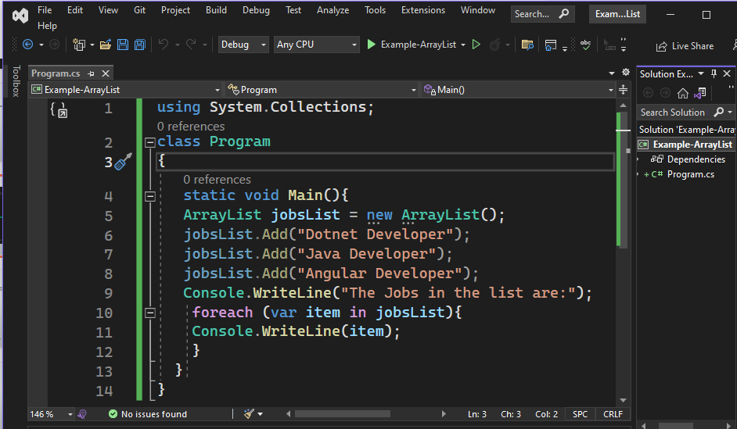
Example

Slide 10

HASHTABLE
In C#, a Hashtable is a collection class that represents a collection of key-value pairs in which keys are unique and the values can be of any type.
It provides a fast way to store and retrieve data by using a hash table algorithm that maps keys to their corresponding values.

Slide 11
The Hashtable class is defined in the System.Collections namespace
It provides methods such as
Add
Remove
Contains
ContainsKey
ContainsValue
Count.

Slide 12
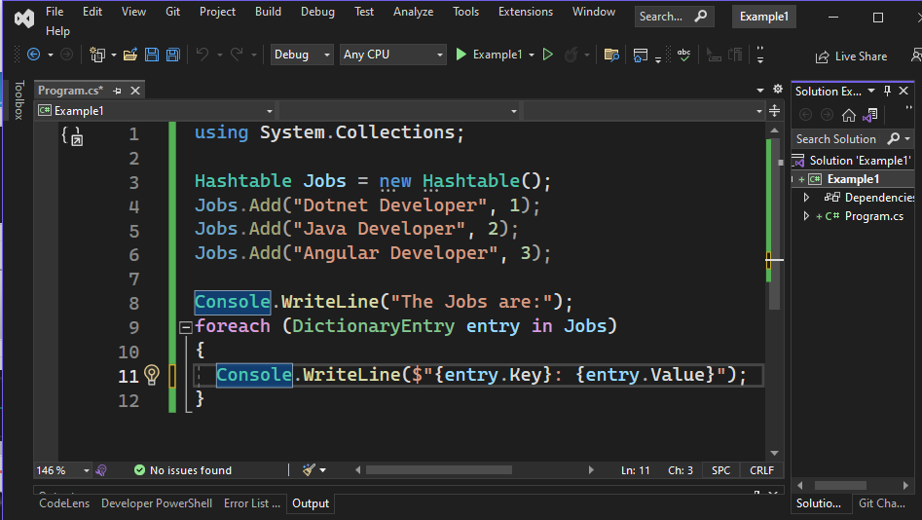
Example

Slide 13

QUEUE
In C#, a Queue is a collection class that represents a first-in, first-out (FIFO) collection of objects.
It provides a way to store and retrieve objects in a "first in, first out" order, where the first object added is the first object to be removed.

Slide 14
The Queue class is defined in the System.Collections namespace
It provides methods such as
Enqueue
Dequeue,
Peek
Count.

Slide 15
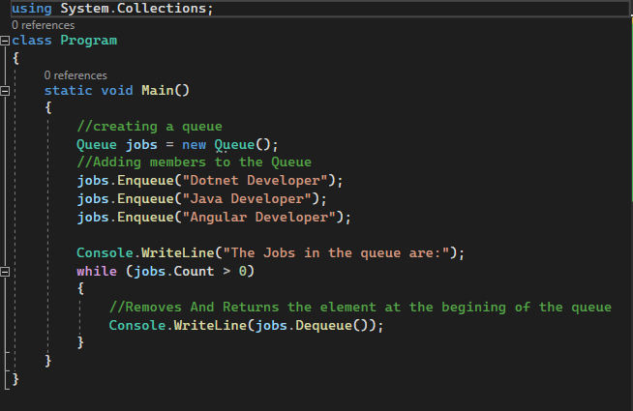
Example

Slide 16

STACK
In C#, a Queue is a collection class that represents a last-in, first-out (LIFO) collection of objects.
It provides a way to store and retrieve objects in a "Last in, first out" order, where the first object added is the first object to be removed.

Slide 17
The Queue class is defined in the System.Collections namespace
It provides methods such as
Enqueue
Dequeue,
Peek
Count.
Contains

Slide 18
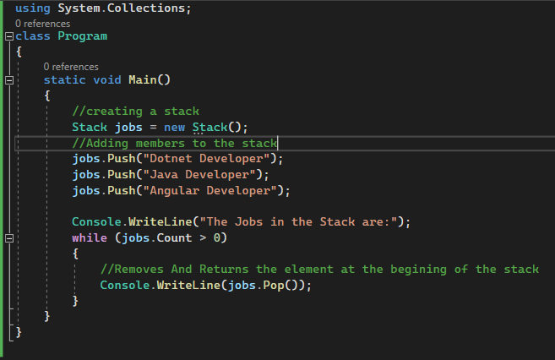
Example

Slide 19

SORTED LIST
Sorted List is a collection class that represents a collection of key-value pairs sorted by key.
A key cannot be a null reference, but a value can be.
SortedList is a combination of the Array and the Hashtable.
A SortedList object automatically sort the items in alphabetic or numeric order.
It uses a binary search algorithm to locate elements quickly.

Slide 20
The Sorted List class is defined in the System.Collections namespace
It provides methods such as
Add
Remove,
Contains key
IndexOfKey
IndexOfValue
Count

Slide 21
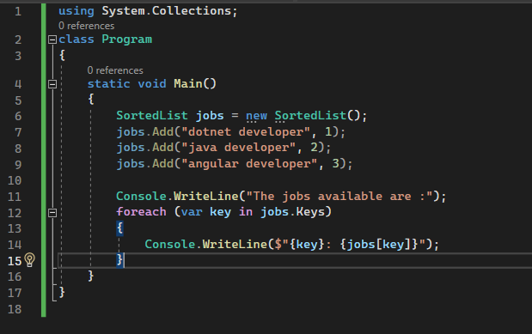
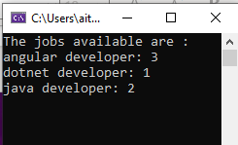
Example

Slide 22

GENERIC COLLECTIONS

Slide 23
Generic collections are collections that are type-safe and can only hold objects of a specifictype.
They are defined in the System.Collections.Generic namespace and include the following classes:
List<T>
Dictionary<Tkey,TValue>
SortedList<TKey,TValue>
Stack<T>
Queue<T>
A dynamic-sized list that can hold objects of type T.
A collection of key/value pairs that maps keys of type TKey to values of type TValue.
A collection of key/value pairs that are sorted by the keys of type TKey.
A collection of objects that supports adding and removing objects in a LIFO (last-in, first-out) manner.
A collection of objects that supports adding and removing objects in a FIFO (first-in, first-out) manner.

Slide 24
LIST<T>
The List<T> in C# is a generic collection that represents a dynamic-sized list of objects of type T.
It is defined in the System.Collections.Generic namespace and provides a flexible way to store and manipulate collections of objects.
The List<T> class is the generic equivalent of the ArrayList class.

Slide 25
Some of the main features of List<T> include:
Dynamic sizing: The size of a List<T> can be modified at runtime, allowing you to add or remove items as needed.
Type safety: Since List<T> is a generic collection, it can only hold objects of type T, which provides type safety and prevents runtime errors.
Index-based access: Items in a List<T> can be accessed by their index, making it easy to retrieve and manipulate specific items in the list.
Built-in functionality : List<T> provides a range of methods for adding, removing, searching, and sorting items in the list.

Slide 26
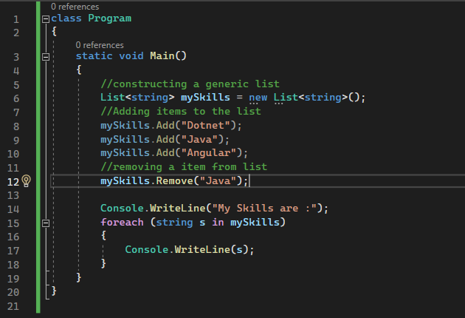
Example

Slide 27
DICTIONARY<TKEY, TVALUE>
It is a generic collection that represents a collection of key/value pairs.
It is defined in the System.Collections.Generic namespace and provides a flexible way to store and manipulate collections of key/value pairs.​

Slide 28
Key/value pairs: A Dictionary<TKey, TValue> stores a collection of key/value pairs. Each key in the dictionary is unique.
Fast lookup: Because Dictionary<TKey, TValue> is implemented as a hash table, accessing an element in the dictionary by key is very fast.
Dynamic sizing: The size of a Dictionary<TKey, TValue> can be modified at runtime, allowing you to add or remove key/value pairs as needed.
Type safety: Since Dictionary<TKey, TValue> is a generic collection, it can only hold objects of type TKey for keys and TValue for values, which provides type safety and prevents runtime errors.

Slide 29
It provides methods such as
Add(TKey key, TValue value)
ContainsKey(TKey key),
ContainsValue(TValue value)
Remove(TKey key)
Clear()

Slide 30
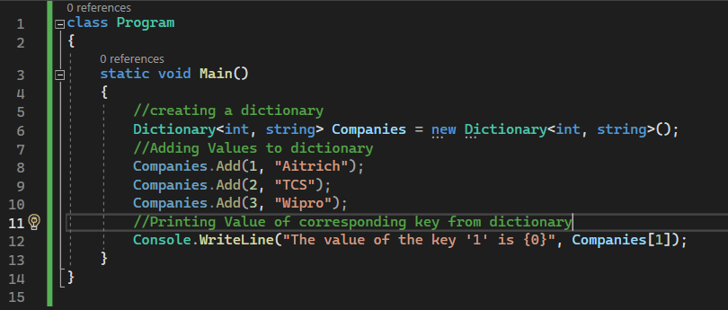
Example

Slide 31
SORTEDLIST<TKEY, TVALUE>
SortedList<TKey, TValue> is a generic collection that represents a collection of key/value pairs that are sorted by key.
It is defined in the System.Collections.Generic namespace and provides a way to store and manipulate collections of key/value pairs in a sorted order.

Slide 32
It provides methods such as
Add(TKey key, TValue value)
ContainsKey(TKey key),
ContainsValue(TValue value)
Remove(TKey key)
Clear()

Slide 33
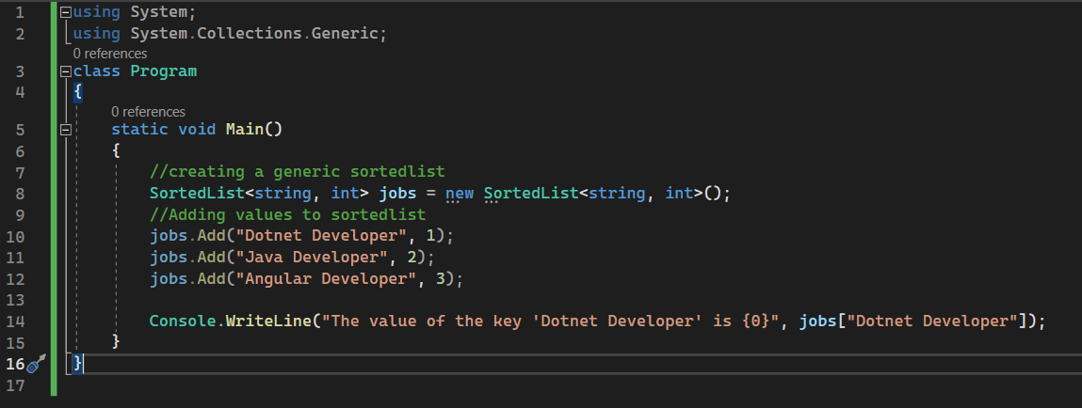
Example

Slide 34
QUEUE<T>
Queue<T> is a generic collection in C# that represents a first-in, first-out (FIFO) data structure.
It is defined in the System.Collections.Generic namespace and provides a way to store and manipulate a collection of objects in the order in which they were added.

Slide 35
It provides methods such as
Enqueue
Dequeue,
Peek
Count.

Slide 36
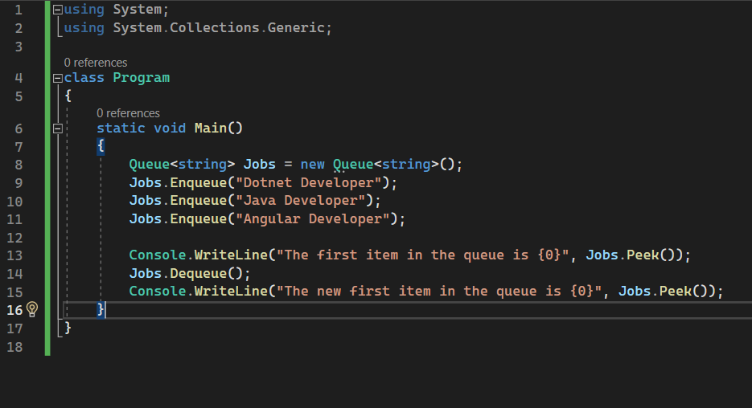
Example

Slide 37
STACK<T>
Stack<T> is a generic collection that represents a last-in, first-out (LIFO) data structure.
It is defined in the System.Collections.Generic namespace and provides a way to store and manipulate a collection of objects in the specific datatype order in which they were added.

Slide 38
It provides methods such as
Enqueue
Dequeue,
Peek
Count.
Contains

Slide 39
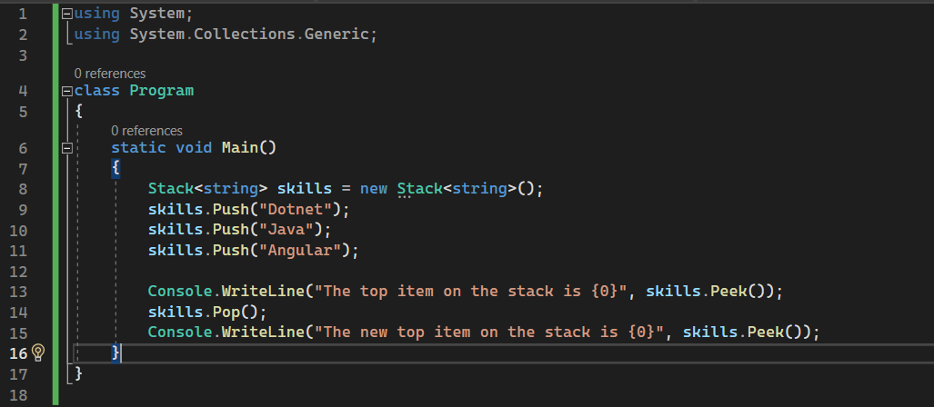
Example

Slide 40
STACK<T>
Stack<T> is a generic collection that represents a last-in, first-out (LIFO) data structure.
It is defined in the System.Collections.Generic namespace and provides a way to store and manipulate a collection of objects in the specific datatype order in which they were added.

Slide 41
LINQ-Language Integrated Query
It is a powerful feature in C# that provides a unified way to query and manipulate data from different data sources. It allows you to write queries against collections, databases, XML documents, and other data sources using a consistent syntax.
LINQ introduces a set of standard query operators that can be used with any data source that implements the IEnumerable<T> interface. These operators are defined as extension methods in the System.Linq namespace.

Slide 42
LINQ - Example
^{static void Main()}
^{{/ Create a list of integers}
List<string> memberList = new List<string> {"JobSeeker","admin","JobProvider"};// Query the list using LINQ
var allMembers = from member in memberList
select member;// Iterate over the query results
foreach (var member in allMembers)
{
^{Console.WriteLine(member);}
}
^{Console.ReadLine();}
}

Slide 43


